Slide 1

Crime Detection Using BigData
This presentation explores how Big Data can be used to identify and analyze crime patterns in a city. By leveraging large datasets, we can gain valuable insights into crime hotspots, predict future trends, and optimize law enforcement strategies.

Slide 2

Importing Libraries and Data Preprocessing
1
Import Libraries
2
Data Loading
This involves importing necessary libraries like Pandas, NumPy, and Pyspark for data manipulation, analysis, and machine learning tasks.
Loading the crime dataset into a suitable data structure, such as a Pandas DataFrame, allows for efficient manipulation and analysis.
3
Data Cleaning
Identifying and handling missing values, duplicates, and inconsistent data entries is crucial for ensuring data quality.

Slide 3



Exploratory Data Analysis
Data Summary
Visualizations
Trend Analysis
Calculating basic statistical measures like mean, median, and standard deviation helps understand the distribution of crime data.
Creating histograms, scatter plots, and heatmaps to visualize relationships between crime types, locations, and time.
Identifying patterns and trends over time, such as seasonal variations or specific crime spikes, provides valuable insights for crime prediction.

Slide 4
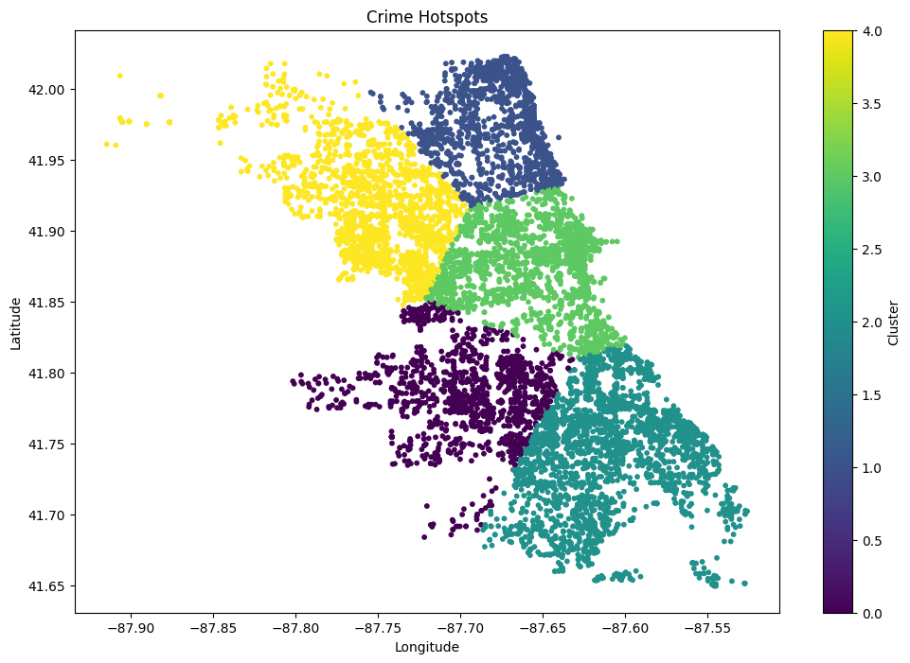
Clustering for Hotspot Detection
1
Feature Selection
Selecting relevant features, such as crime type, location coordinates, and time, for clustering.
2
Clustering Algorithm
Applying an appropriate clustering algorithm, such as K-means or DBSCAN, to group similar crime occurrences.
3
Cluster Analysis
Analyzing the characteristics of each cluster to identify crime hotspots and understand their underlying patterns.

Slide 5
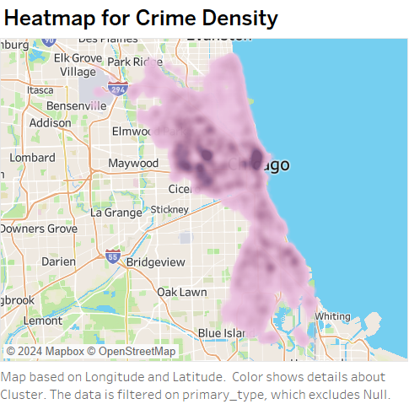

Visualization of Crime Hotspots
Heat Maps:
Crime density visualization uses color gradients on a city map, where darker shades highlight areas with higher crime rates, helping identify hotspots and patterns for effective resource allocation and planning.

Slide 6
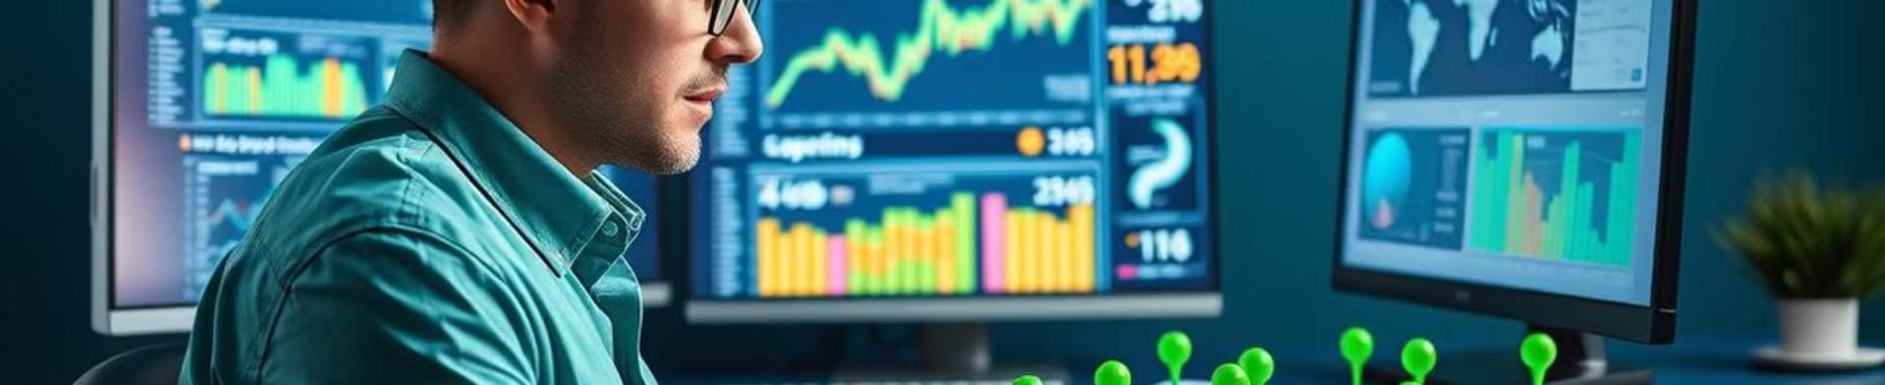
Save and Export Results
Data Storage
Exporting Reports
Storing the processed crime data and analysis results in a database or file format suitable for future reference.
Generating reports in formats like CSV, Excel, or PDF, containing summarized insights and visualizations.

Slide 7
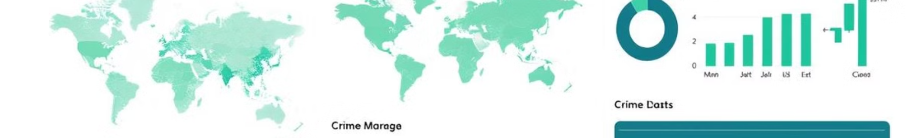



Deployed Insights Using TABLEAU Dashboard
Data Preparation
Connecting the crime dataset to TABLEAU and preparing the data for visualization.
Dashboard Design
Creating a user-friendly dashboard with interactive visualizations and filters to explore crime data.
Deployment
Publishing the dashboard online or sharing it with stakeholders, allowing them to access and analyze insights easily.

Slide 8
REFERENCE:
Research Paper
Data
Dashboard
https://www.irjet.net/archives/V11/i4/IRJET-V11I4287.pdf
https://data.torontopolice.on.ca/
https://www.tps.ca/data-maps/data-analytics/major-crime-indicators/

Slide 9

Conclusion
Big Data analytics provides a powerful tool for crime detection, enabling law enforcement to better understand crime patterns, predict potential risks, and optimize resource allocation. These insights can significantly contribute to improving public safety and creating safer communities.

Slide 10
THANK YOU !!!

